Slide 1
^{The Semantic Web:} ^{Ontologies and OWL}
Summary
Ian Horrocks and Alan Rector
http://www.cs.man.ac.uk/~horrocks/Teaching/cs646

Slide 2
Summary 1
DLs are family of object oriented KR formalisms related to frames and Semantic networks
  Distinguished by formal semantics and inference services
Semantic Web aims to make web resources accessible to automated processes
  Ontologies will play key role by providing vocabulary for semantic markup
OWL is a DL based ontology language designed for the Web
  Exploits existing standards: XML, RDF(S)
  Adds KR idioms from object oriented and frame systems
  W3C recommendation and already widely adopted in e-Science
  DL provides formal foundations and reasoning support

Slide 3
Summary 2
Reasoning is important because
  Understanding is closely related to reasoning
  Essential for design, maintenance and deployment of ontologies
Reasoning support based on DL systems
  Sound and complete reasoning
  Highly optimised implementations
Challenges remain
  Reasoning with full OWL language
  (Convincing) demonstration(s) of scalability
  New reasoning tasks
  Development of (more) high quality tools and infrastructure

Slide 4
Description Logics

Slide 5
Description Logics
A family of logic based Knowledge Representation formalisms
  Descendants of semantic networks and KL-ONE
  Describe domain in terms of concepts (classes), roles (relationships) and individuals
Distinguished by:
  Formal semantics (typically model theoretic)
    Decidable fragments of FOL
    Closely related to Propositional Modal & Dynamic Logics
  Provision of inference services
    Sound and complete decision procedures for key problems
    Implemented systems (highly optimised)
Many applications, including:
  Databases
  Formal and computational foundations of Ontology Languages

Slide 6
DL Architecture
Knowledge Base
Tbox (schema)
Man ´ Human u Male
Happy-Father ´ Man u 9 has-child Female u …
Interface
Inference System
Abox (data)
John : Happy-Father
hJohn, Maryi : has-child
John: 6 1 has-child

Slide 7
The Semantic Web

Slide 8
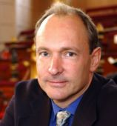
Semantic Web
Web was “invented” by Tim Berners-Lee (amongst others), a physicist working at CERN
His vision of the Web was much more ambitious than the reality of the existing (syntactic) Web:
This vision of the Web has become known as the Semantic Web
“… a plan for achieving a set of connected applications for data on the Web in such a way as to form a consistent logical web of data …”
“… an extension of the current web in which information is given well-defined meaning, better enabling computers and people to work in cooperation …”

Slide 9
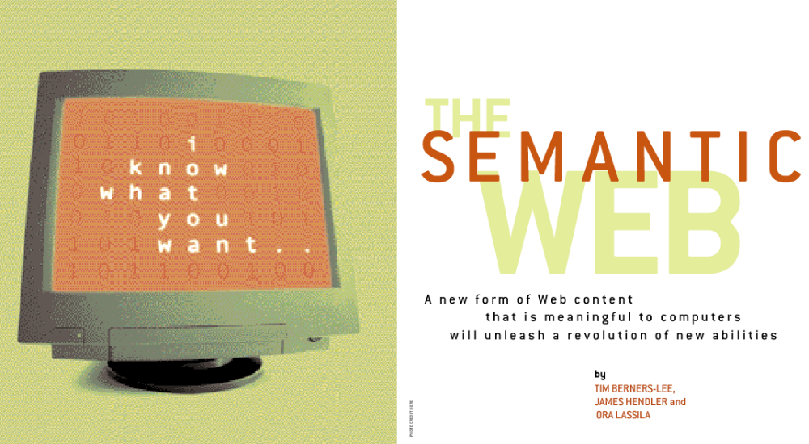
Scientific American, May 2001:
Beware of the Hype!
Can make a start by adding semantic annotation to web resources
Already seeing exciting applications of technology in e-Science

Slide 10
Adding “Semantic Markup”
Make web resources more accessible to automated processes by:
Extend existing rendering markup with semantic markup
  Metadata annotations that describe content/function of web accessible resources
Useing Ontologies to provide vocabulary for annotations
  “Formal specification” is accessible to machines
“Semantics” given by ontologies
  Ontologies provide a vocabulary of terms used in annotations
  New terms can be formed by combining existing ones
  Meaning (semantics) of such terms is formally specified
  Need to agree on a standard web ontology language
A prerequisite is a standard web ontology language
  Need to agree common syntax before we can share semantics

Slide 11
RDF, RDFS

Slide 12
RDF and RDFS
RDF stands for Resource Description Framework
It is a W3C recommendation (http://www.w3.org/RDF)
RDF is graphical formalism ( + XML syntax + semantics)
  for representing metadata
  for describing the semantics of information in a machine- accessible way
RDFS extends RDF with “schema vocabulary”, e.g.:
  Class, Property
  type, subClassOf, subPropertyOf
  range, domain

Slide 13
RDF Syntax: Triples and Graphs
« Ian Horrocks »
« University of Manchester »
ex:name
ex:name
_:xxx
_:yyy
ex:member-of
rdf:type
rdf:type
ex:Person
ex:Organisation
Jean-François Baget

Slide 14
RDFS
RDFS vocabulary adds constraints on models, e.g.:
  8x,y,z type(x,y) and subClassOf(y,z) ) type(x,z)
ex:Person
ex:Animal
rdfs:subClassOf
ex:John
rdf:type
ex:Person
rdf:type
ex:Animal

Slide 15
Problems with RDFS
RDFS too weak to describe resources in sufficient detail
  No localised range and domain constraints
    Can’t say that the range of hasChild is person when applied to persons and elephant when applied to elephants
  No existence/cardinality constraints
    Can’t say that all instances of person have a mother that is also a person, or that persons have exactly 2 parents
  No transitive, inverse or symmetrical properties
    Can’t say that isPartOf is a transitive property, that hasPart is the inverse of isPartOf or that touches is symmetrical
  …
Difficult to provide reasoning support
  No “native” reasoners for non-standard semantics
  May be possible to reason via FO axiomatisation

Slide 16
OWL

Slide 17
OWL Class Constructors
Lots of redundancy, e.g., use negations to transform and to or and exists to forall

Slide 18
OWL Axioms
Axioms (mostly) reducible to inclusion (v)
  C ´ D iff both C v D and D v C

Slide 19
Reasoning with OWL

Slide 20
Why do we want/need to reason with OWL?
1. Philosophical Reasons
Semantic Web aims at “machine understanding”
Understanding closely related to reasoning
  Recognising semantic similarity in spite of syntactic differences
  Drawing conclusions that are not explicitly stated

Slide 21
2. Practical Reasons
Given key role of ontologies in e-Science and Semantic Web, it is essential to provide tools and services to help users:
  Design and maintain high quality ontologies, e.g.:
    Meaningful — all named classes can have instances
    Correct — captured intuitions of domain experts
    Minimally redundant — no unintended synonyms
    Richly axiomatised — (sufficiently) detailed descriptions
  Store (large numbers) of instances of ontology classes, e.g.:
    Annotations from web pages (or gene product data)
  Answer queries over ontology classes and instances, e.g.:
    Find more general/specific classes
    Retrieve annotations/pages matching a given description
  Integrate and align multiple ontologies

Slide 22
Why Decidable Reasoning?
OWL constructors/axioms restricted so reasoning is decidable
Consistent with Semantic Web's layered architecture
  XML provides syntax transport layer
  RDF(S) provides basic relational language and simple ontological primitives
  OWL provides powerful but still decidable ontology language
  Further layers (e.g. SWRL) will extend OWL
    Will almost certainly be undecidable
Facilitates provision of reasoning services
  “Practical” algorithms for sound and complete reasoning
  Several implemented systems
  Evidence of empirical tractability

Slide 23
Why Sound & Complete Reasoning?
Important for ontology design
  Ontologists need to have complete confidence in reasoner
  Otherwise they will cease to trust results
  Doubting unexpected results makes reasoner useless
Important for ontology deployment
  Many realistic web applications will be agent ↔ agent
  No human intervention to spot glitches in reasoning
Incomplete reasoning might be OK in 3-valued system
  But “don’t know” typically treated as “no”

Slide 24
Basic Inference Tasks
Knowledge is correct (captures intuitions)
  Does C subsume D w.r.t. ontology O? (in every model I of O, C^{I} µ D^{I} )
Knowledge is minimally redundant (no unintended synonyms)
  Is C equivallent to D w.r.t. O? (in every model I of O, C^{I} = D^{I} )
Knowledge is meaningful (classes can have instances)
  Is C is satisfiable w.r.t. O? (there exists some model I of O s.t. C^{I} ≠ ; )
Querying knowledge
  Is x an instance of C w.r.t. O? (in every model I of O, x^{I} 2 C^{I} )
  Is hx,yi an instance of R w.r.t. O? (in every model I of O, (x^{I},y^{I}) 2 R^{I} )
All reducible to KB satisfiability or concept satisfiability w.r.t. a KB
Can be decided using highly optimised tableaux reasoners

Slide 25
DL Reasoning

Slide 26
Tableaux Algorithms
Try to prove satisfiability by building model of input concept
  Tree model property (if there is a model, then there is a tree shaped model), so can limit attention to tree models
  If no tree model can be found, then input concept unsatisfiable
Work on concepts in negation normal form
  Push negations inwards using De Morgan’s etc.
Use tableaux rules to break down syntax of concepts
  Rules correspond to language constructors
  Rules add new individuals or constraints on individuals
  Nondeterministic rules → search of different possible models
Stop (and backtrack) if clash (a in C and not C for some a)
Blocking (cycle check) ensures termination for more expressive logics

Slide 27
DL Reasoning: Highly Optimised Implementations
DL reasoning based on tableaux algorithms
Naive implementation → effective non-termination
Modern systems include MANY optimisations
Optimised classification (compute partial ordering)
  Enhanced traversal (exploits information from previous tests)
  Use structural information to select classification order
Optimised subsumption testing (search for models)
  Normalisation and simplification of concepts
  Absorption (simplification) of axioms
  Dependency directed backtracking
  Caching of satisfiability results and (partial) models
  Heuristic ordering of propositional and modal expansion
  …

Slide 28
Research Challenges
Increased expressive power
  Existing DL systems implement (at most) SHIQ
  OWL extends SHIQ with datatypes and nominals (SHOIN(D_{n}))
  Future (undecidable) extensions such as SWRL
Scalability
  Very large ontologies
  Reasoning with (very large numbers of) individuals
Other reasoning tasks
  Querying
  Matching
  Least common subsumer
  ...
Tools and Infrastructure
  Support for large scale ontological engineering and deployment

Slide 29
Resources
Course materials
  http://www.cs.man.ac.uk/~horrocks/Teaching/cs646/
Protégé
  http://protege.stanford.edu/plugins/owl/
W3C Web-Ontology (WebOnt) working group (OWL)
  http://www.w3.org/2001/sw/WebOnt/
DL Handbook, Cambridge University Press
  http://books.cambridge.org/0521781760.htm

Slide 30
Select Bibliography
Ian Horrocks, Peter F. Patel-Schneider, and Frank van Harmelen. From SHIQ and RDF to OWL: The making of a web ontology language. Journal of Web Semantics, 2003.
Franz Baader, Ian Horrocks, and Ulrike Sattler. Description logics as ontology languages for the semantic web. In Festschrift in honor of Jörg Siekmann, LNAI. Springer, 2003.
I. Horrocks and U. Sattler. Ontology reasoning in the SHOQ(D) description logic. In Proc. of IJCAI 2001.
All available from http://www.cs.man.ac.uk/~horrocks/Publications/

